Slide 1
Principal and Interest
Farm Business Planning – Lesson 2

Slide 2
A Project Funded by:
USDA BFRDP
Grant #10506276
Development Partners Include:
Mississippi State University
National Association of Agricultural Educators
Oklahoma State University
Agricultural Economics Department
Oklahoma Cooperative Extension Service

Slide 3
What is P&I?
Principal is the amount of money borrowed for a loan
New car costs $16,500 and you pay $2,000 down payment (cash from pocket) you will need a bank loan for $14,500 - $14,500 is the loan principal
Interest is the amount a bank charges to “use” their money.
The car loan is financed with a 6% loan. Meaning each month the bank will charge you 6% interest on the principal balance you still owe them. The month of loan would be $870 in interest charges.

Slide 4
Cash Expenses
Feed, fuel, veterinary, utilities, insurance, property taxes, hired labor, seed, fertilizer, rent,…
Interest on operating expenses
Paid on percent of operating expenses that are financed with debt
Note, “interest on percent financed with equity is a non-cash expense” (Opportunity cost)
NOT AN EXPENSE—Principal payments!

Slide 5
Cash Expenses: Operating Interest
How to estimate operating interest
Cash operating expenses ÷ 2
Multiply annual interest rate ÷12
Multiply number of months in project
Multiply amount of cash expenses financed (debt)

Slide 6
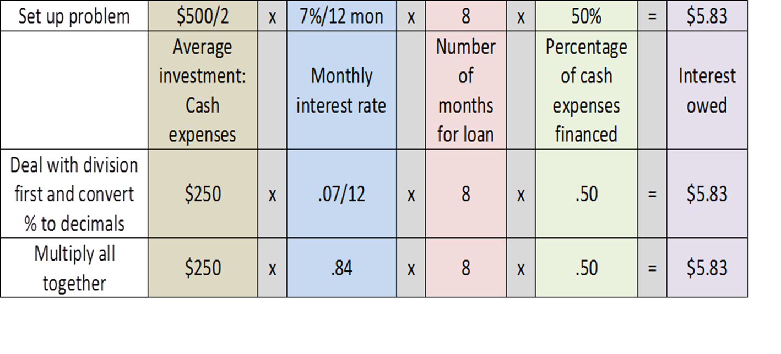
Operating Interest Example
$500 cash expenses, 50% debt financed
8 months in growing season
7% interest rate

Slide 7
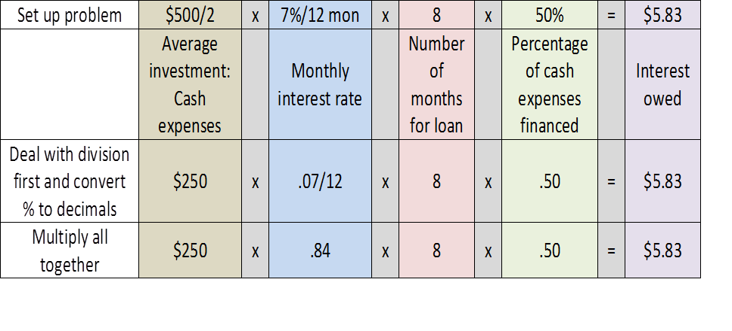
What the Numbers Mean
$500 cash expenses with 50% debt financed
$250 principal – principal is not a cash expense
$5.83 is the estimated interest
Interest is a cash expense

Slide 8
Special Thanks to:
USDA BFRDP Grant Program
Oklahoma State University
Eric A. DeVuyst, Department of Agricultural Economics
National Association of Agricultural Educators

