Slide 1
Photography
In
Agriculture

Slide 2
To do list:
Explain the uses and characteristics of photography in agricultural communications
Describe how photography affects the agricultural industry

Slide 3
Agricultural Photography
Reaches a diverse industry
Those in agriculture
Those outside of agriculture

Slide 4
Major areas of photography in agriculture
Marketing and sales
Disease identification
Pest identification
Livestock Showing

Slide 5
Marketing and sales
Purebred livestock breeders
Show livestock breeders
Agricultural equipment sales

Slide 6
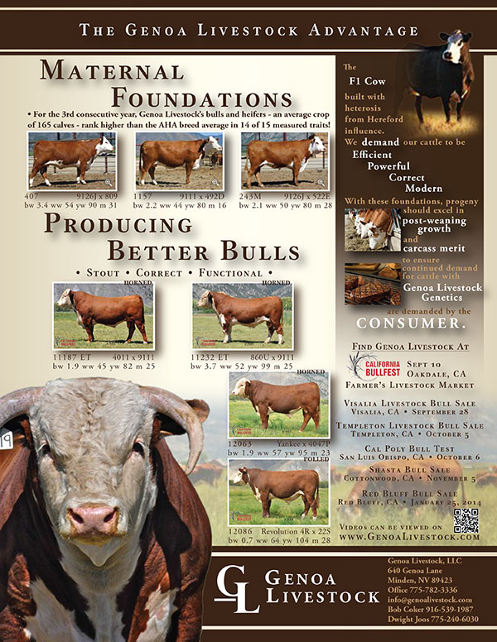
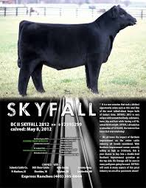
Purebred livestock breeders

Slide 7
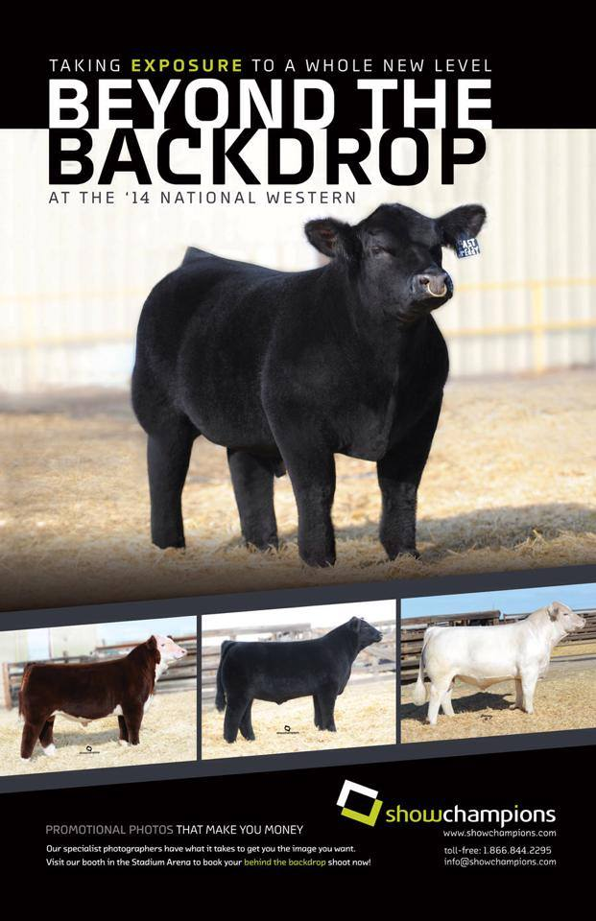
Show stock breeders

Slide 8
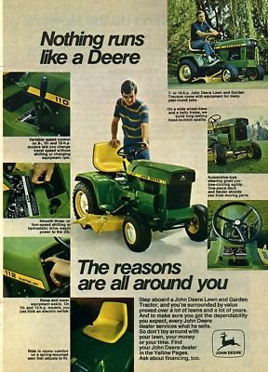
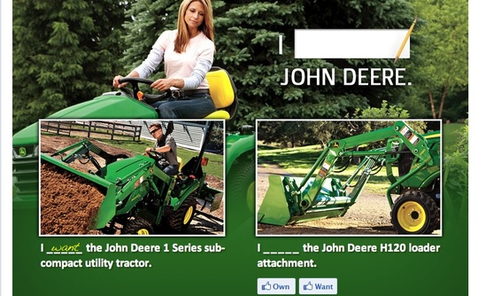
Agricultural Equipment Sales

Slide 9
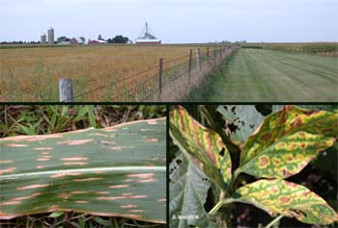
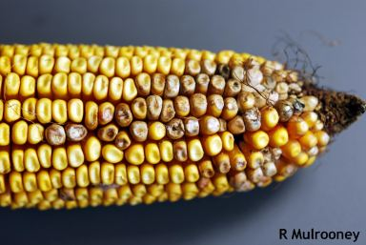
Disease Identification

Slide 10
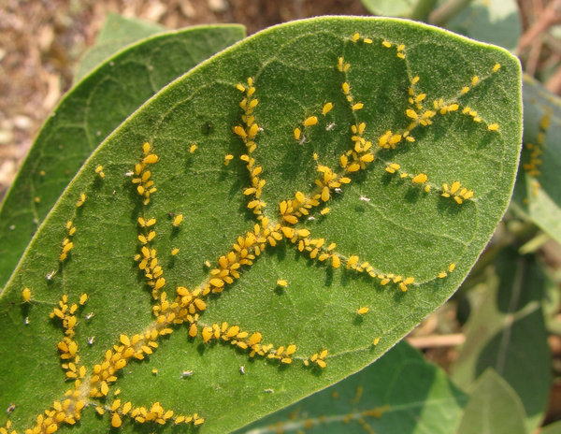
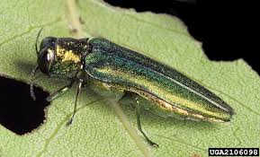
Pest Identification

Slide 11
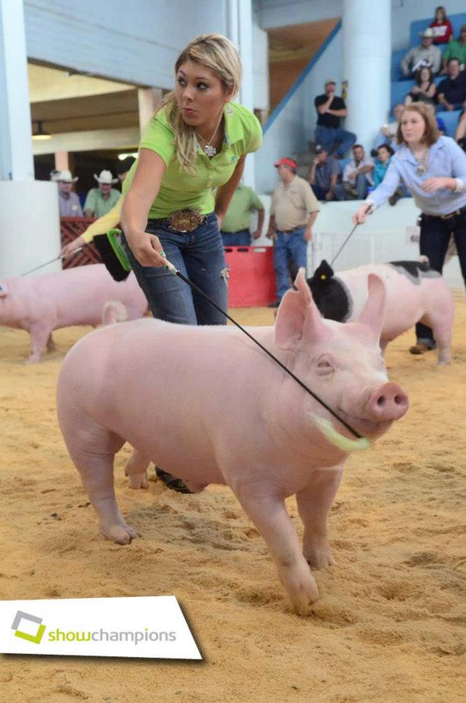
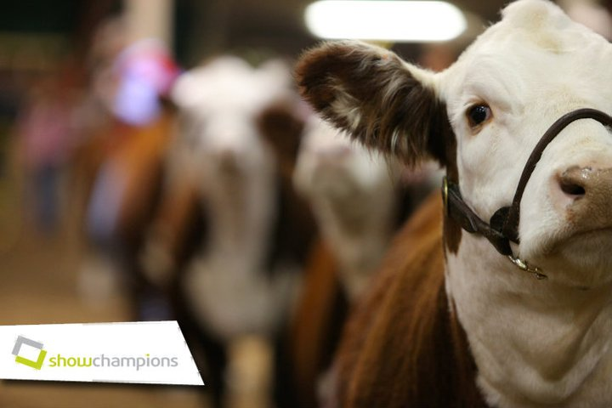
Show
industry

Slide 12
Lets talk $$
Salary varies
35,000-50,000/year
More or less
Depends on company and other job responsibilities

