Slide 1
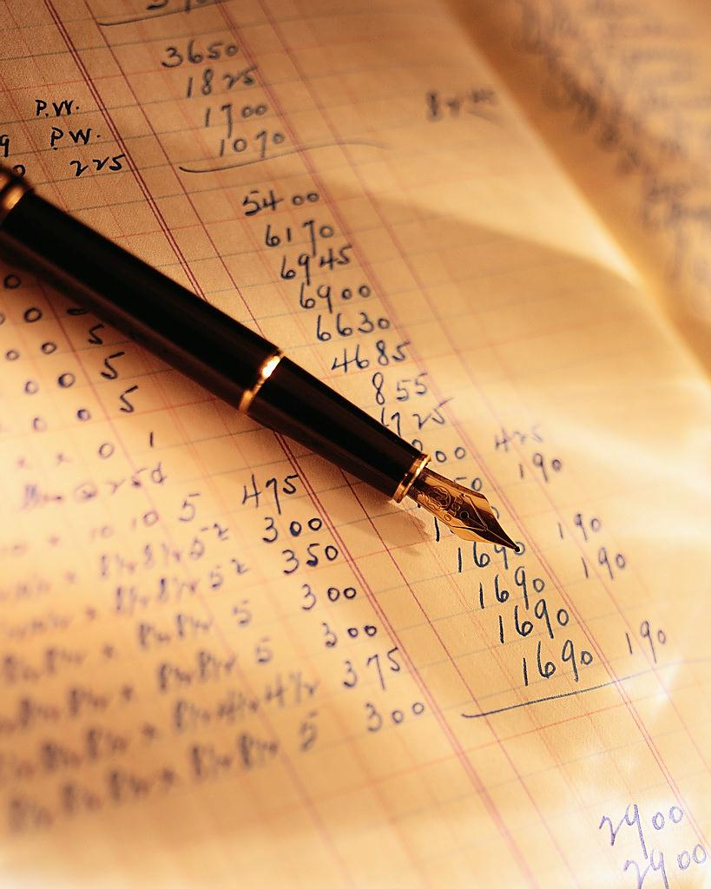
Analysis of Health
Farm Business Planning – Lesson 3

Slide 2
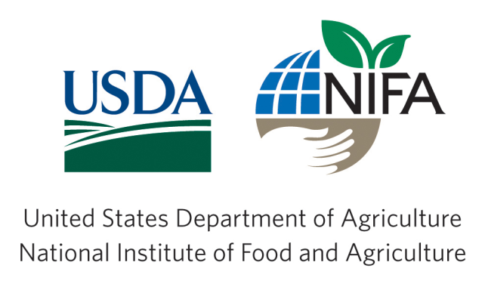
A Project Funded by:
USDA BFRDP
Grant #10506276
Development Partners Include:
Mississippi State University
National Association of Agricultural Educators
Oklahoma State University
Agricultural Economics Department
Oklahoma Cooperative Extension Service

Slide 3
The Two Measures
Solvency
Solvency measures the business’ ability to payoff all financial obligations
Liquidity
A measure of the extent to which a person or organization has cash to meet immediate and short-term obligations, or assets that can be quickly converted to do this.

Slide 4
Solvency Calculations
Debt-to-asset ratio (D/A) = portion of assets “owed” to creditors
Equity-to-asset ratio (E/A)= portion of assets “owned” by the business owners
Debt-to-equity ratio (D/E)= relative portion of debt financing to equity financing
Also call “leverage ratio”

Slide 5
Solvency Analysis
Want D/A to be small
Want E/A to be big
Can never be over 1.0
Want D/E to be small
Can never be less than 0

Slide 6
Liquidity Calculations
Working capital = current assets – current liabilities
Want > 0
Current ratio = Current assets / current liabilities
Want > 1
Businesses with lots of sales will have a high current ratio

Slide 7
Special Thanks to:
USDA BFRDP Grant Program
Oklahoma State University
Eric A. DeVuyst, Department of Agricultural Economics
National Association of Agricultural Educators

